Slide 1

ESU Math Day
Algebra Team Contest
Wednesday, October 23, 2019

Slide 2
Instructions
Always give exact answers.
Right:
Wrong:
Simplify answers. For example, 26/4 should be simplified to 13/2, but 28/3 should be kept as it is.
Remember to include appropriate units in the answer.
You may use a graphing calculator.

Slide 3


Problem 1 | 60 seconds | 3 points
Solve the following equation:
$$5\left(3x−2\right)+5x−7=2x+16$$
Answer:
$$x=11/6$$

Slide 4


Problem 2 | 90 seconds | 5 points
Find the solution(s) to the following inequality:
$$−6x^{2}+7x≤−20.$$
$x≤−\frac{4}{3}$or$x≥\frac{5}{2}$
Or $\left(−∞, −\frac{4}{3}\right]∪\left[\frac{5}{2}, ∞\right)$
Answer:

Slide 5


Problem 3 | 75 seconds | 5 points
Find all real zeros of the function:
$$f\left(x\right)=2x^{3}+14x^{2}+24x$$
Answer:
$$x=0, −3, −4$$

Slide 6


Problem 4 | 90 seconds | 5 points
Solve for $x$:
$$3^{4x+5}−{27}^{x}=0$$
Answer:
$$x=−5$$

Slide 7
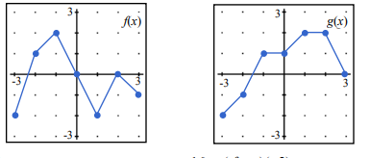




Problem 5 | 30 seconds | 3 points
Find $(g∘f)(−3):$
$$f(x)$$
$$g(x)$$
Answer:
$$−1$$

Slide 8

Problem 6 | 45 seconds | 3 points
Solve the equation $z=\frac{x−μ}{σ}$ for $μ. Assume σ$ $≠0.$
Answer:
$$μ=x−zσ$$

Slide 9

Problem 7 | 45 seconds | 3 points
Find the distance between the points
$(3,−1)$ and $(7,2)$.
Answer:
$$5$$

Slide 10


Problem 8 | 60 seconds | 3 points
For positive numbers a, k, and s, find the solution for the following inequality:
$$\left|x−a\right|<ks$$
Answer:
$\left(a−ks,a+ks\right)$ or
$$a−ks<x<a+ks$$

Slide 11

Problem 9 | 60 seconds | 4 points
Lambs and ducks are out in a pasture. A hawk flying over counts 80 heads. A field mouse counts 246 feet. How many lambs are there?
Answer:
$$43$$

Slide 12

Problem 10 | 90 seconds | 5 points
Suppose your stock portfolio decreases in value by 25%. What percentage must it increase in value so that it has the same value as it did before the decrease?
$$33\frac{1}{3}\%$$
Answer:

Slide 13
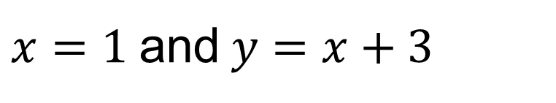

Problem 11 | 120 seconds | 6 points
Determine the equations of all asymptotes of
$$f\left(x\right)=\frac{\left(x^{2}−2x−3\right)\left(x+5\right)}{x^{2}−1}$$
Answer:
$x=1$and$y=x+3$

Slide 14


Problem 12 | 45 seconds | 4 points
Let $x=76$. Find $\log_{3}{x}$. Round your answer to the nearest hundredth.
Answer:
$$3.94$$

Slide 15

Problem 13 | 120 seconds | 6 points
Find the sum of the first 85 positive odd integers.
Answer:
$$7225$$

Slide 16


Problem 14 | 45 seconds | 3 points
Simplify as much as possible. Leave no negative exponents in your answer. Assume $a≠0, b≠0.$
$$\frac{{(a}^{−1}+b^{−1})}{{\left(ab\right)}^{−1}}$$
Answer:
$$a+b$$

Slide 17

Problem 15 | 45 seconds | 3 points
What positive number N has the property that if the following steps are performed successively, beginning with N, the final result is 2? The steps are as follows: divide by 3, then square, then subtract 52, then take the square root, then add 8, then divide by 10.
Answer:
$$N=42$$

Slide 18
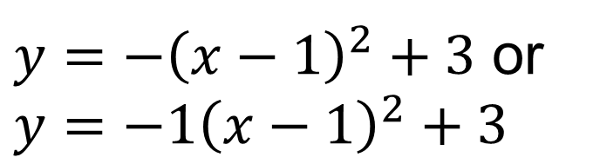
Problem 16 | 60 seconds | 4 points
Find the equation of the quadratic function that has a vertex of (1, 3) and passes through the point (-2, -6).
Answer:
$y=−{\left(x−1\right)}^{2}+3$ or $y=−1{\left(x−1\right)}^{2}+3$

Slide 19
Problem 17 | 60 seconds | 4 points
Suppose a town is growing exponentially at a rate of 2% per year. Determine the number of years it takes for the population of the town to double in size. Round your answer to the nearest whole number.
Answer:
35 years

Slide 20

Problem 18 | 60 seconds | 4 points
What is the units digit of $7^{399}$?
Answer:
3

Slide 21


Problem 19 | 45 seconds | 4 points
Solve for $x$ in the equation $3log⁡(2x)=6$.
Answer:
$$x=50$$

Slide 22
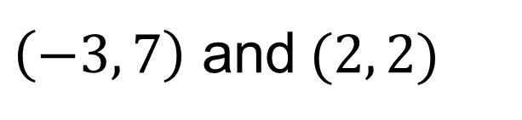
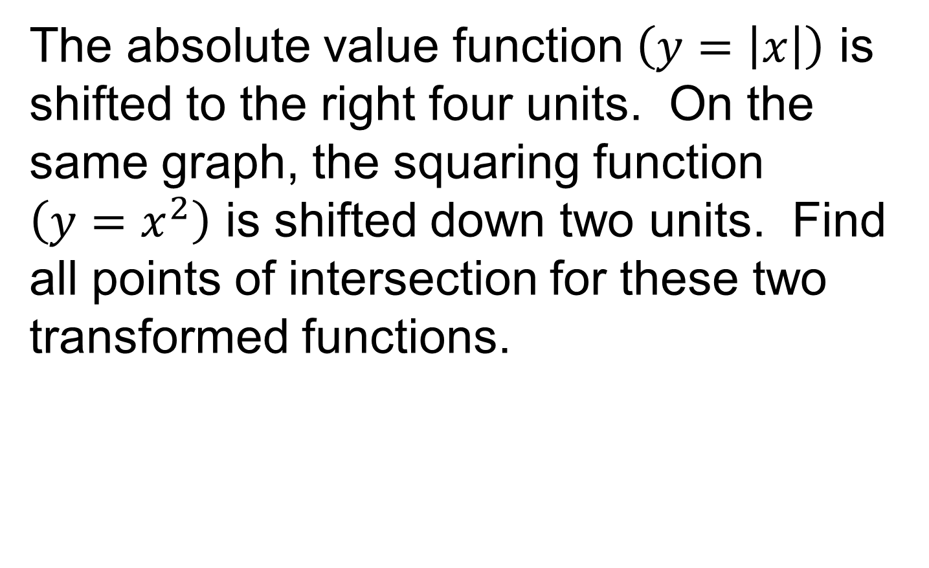
Problem 20 | 120 seconds | 5 points
The absolute value function $\left(y=\left|x\right|\right)$ is shifted to the right four units. On the same graph, the squaring function $\left(y=x^{2}\right)$ is shifted down two units. Find all points of intersection for these two transformed functions.
Answer:
$\left(−3, 7\right)$ and$(2, 2)$

Slide 23

Problem 21 | 60 seconds | 4 points
If a and b are solutions of $x^{2}+2x−5=0$, what is the value of $a^{2}+b^{2}$?
Answer:
14

Slide 24


Problem 22 | 120 seconds | 6 points
Find the value of the infinite sum:
$$1+\frac{1}{2}−\frac{2}{3}+\frac{1}{4}−\frac{4}{9}+\frac{1}{8}−\frac{8}{27}+…$$
Answer:
$$0$$

Slide 25


Problem 23 | 120 seconds | 7 points
What is the coefficient of the $x^{2}y^{7}$ term in the expansion of ${\left(7x−2y\right)}^{9}?$
Answer:
$$−225,792$$

Slide 26
This page is intentionally left blank.

Slide 28
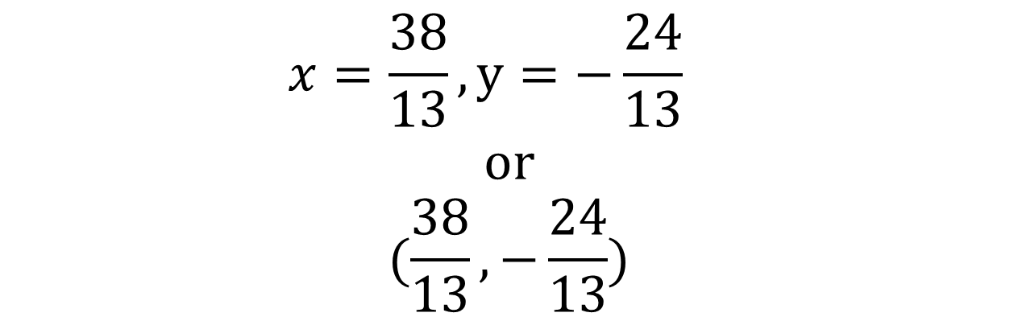

Tie Breaker 1
Solve the system:
$$3x−5y=18$$
$$4x+2y=8$$
$$x=\frac{38}{13}, y=−\frac{24}{13}$$
$$or$$
$$(\frac{38}{13},−\frac{24}{13})$$
Answer:

Slide 29
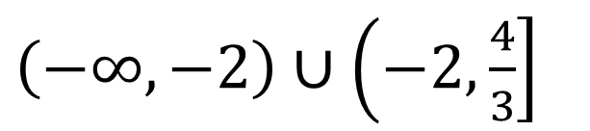

Tie Breaker 2
Find the domain of $f\left(x\right)=\frac{\sqrt{4−3x}}{x+2}$.
Express your answer in interval notation.
$\left(−∞,−2\right)∪\left(−2,\frac{4}{3}\right]$
Answer:

